Slide 1
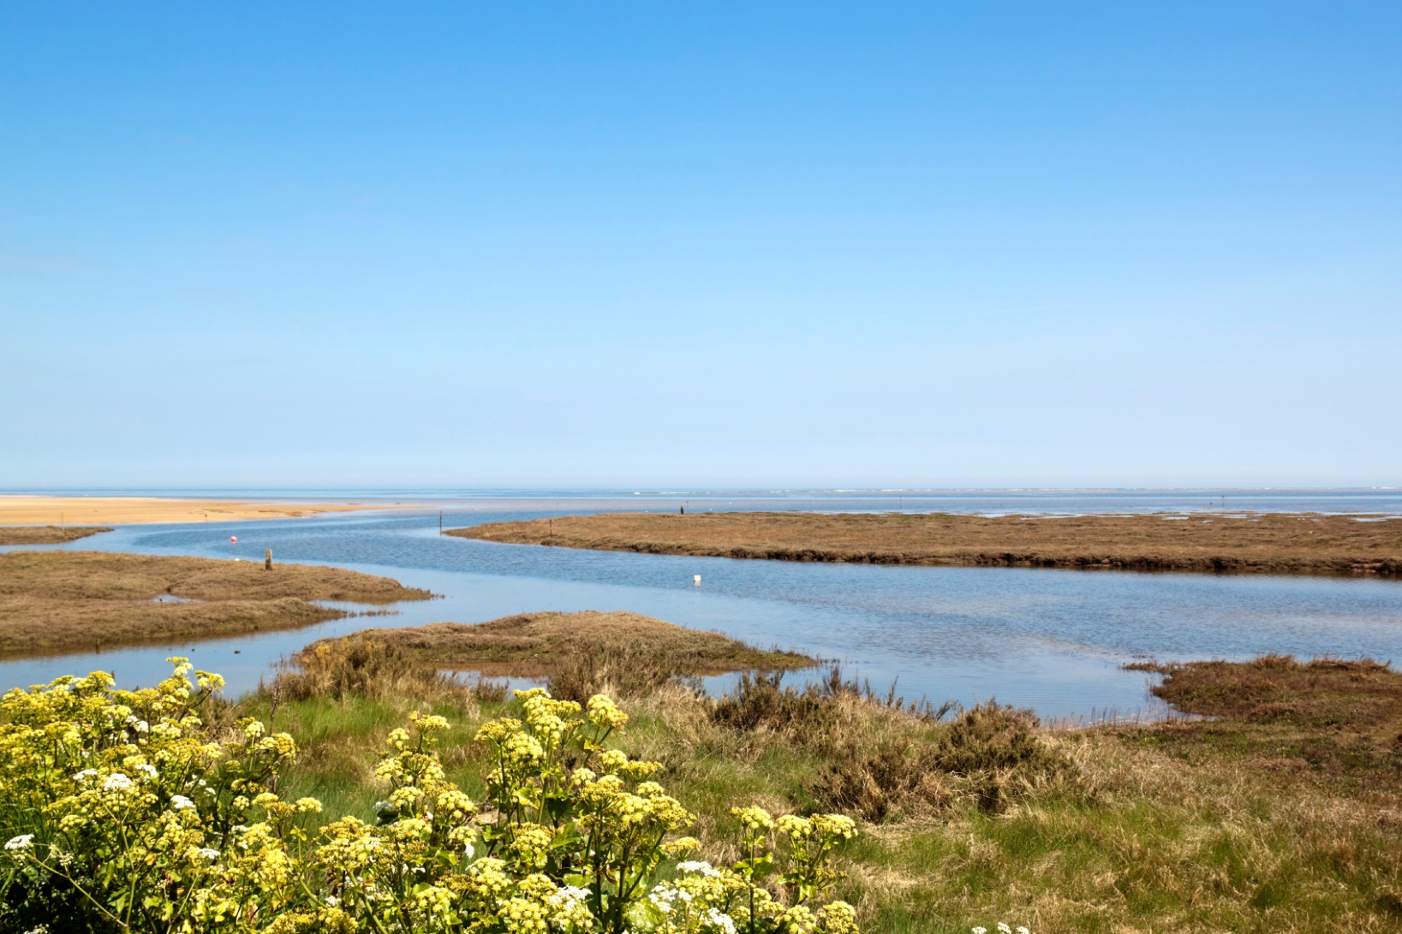
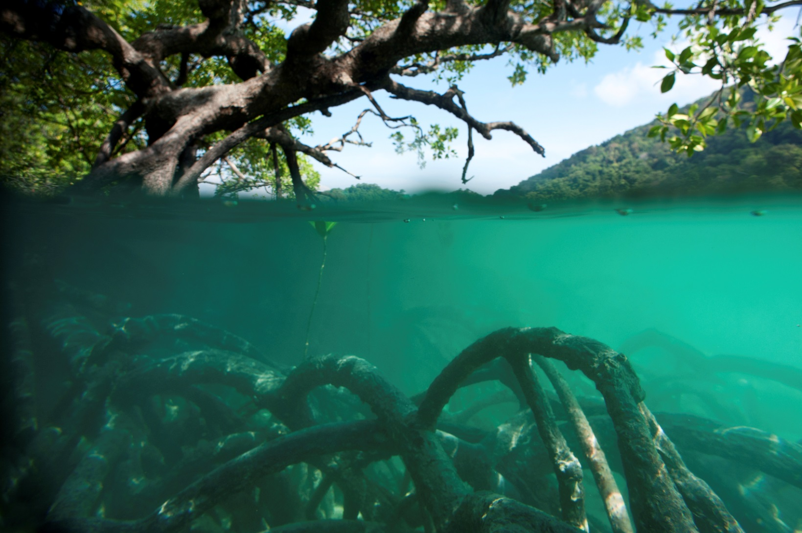
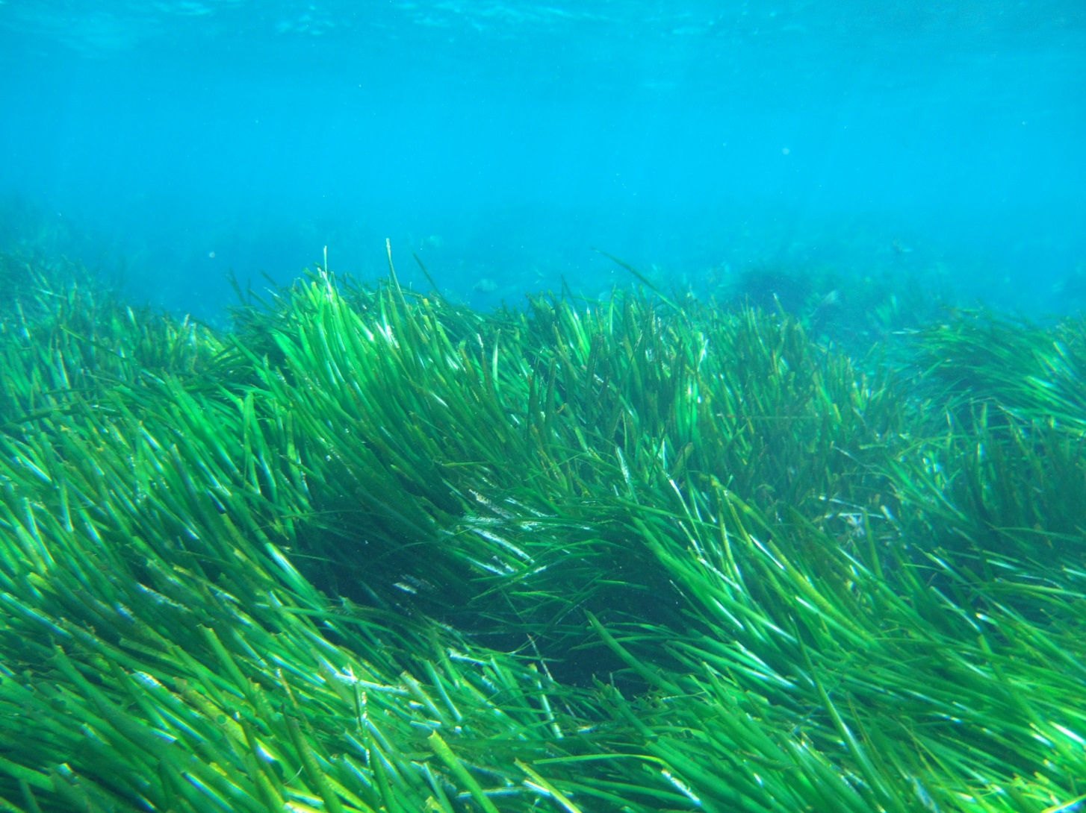
Ms. Inger Andersen, Director General
International Union for the Conservation of Nature
Blue Carbon and Nature-based Mitigation
Oceans Day at COP 21 - 4 December 2015

